Slide 1
DSI 8 – Project 1
EDA and Data Wrangling for
SAT and ACT scores, 2017 - 2018
By Alfred Tang
DSI 8, General Assembly
23 May 2019

Slide 2
Introduction
SAT format changed in 2016
Now there are 2 years of data to compare, post-change
Task: Analyse data and present findings to College Board staff

Slide 3
Problem Statement
In which states are participation rates increasing after re-design of SAT?
Are more students achieving the benchmark scores after the re-design?

Slide 4
DATA Cleaning (2017)
Issues:
Row counts not matching
ACT 2017 National Composite
Typos
SAT 2017 Maryland Math Score → 52 instead of 524

Slide 5
DATA Cleaning (2017)
Issues (Cont’d):
Data Entry
ACT 2017 Wyoming Composite → 20.2x
ACT 2017 Maryland Science → 2.3 → 23.2
Data Types
Participation entered as strings
Replaced % with blank; converted to float

Slide 6
DATA Gathering (2018)
Issues:
Source Data not complete
Composite column was the only usable column
Separately gathered score data
Data not matching
SAT scores did not match Totals
+1/-1 differences ignored.
Difference is due to rounding
Officially stated by College Board.

Slide 7
DATA Cleaning (2018)
Issues:
Row counts not matching
2018 National averages
Data Types
Participation again entered as strings

Slide 8
Exploratory Data Analysis
 | count | mean | std | min | 25% | 50% | 75% | max
sat_2017_participation | 51.0 | 0.398039 | 0.352766 | 0.02 | 0.040 | 0.38 | 0.660 | 1.0
sat_2017_erw | 51.0 | 569.117647 | 45.666901 | 482.00 | 533.500 | 559.00 | 613.000 | 644.0
sat_2017_math | 51.0 | 556.882353 | 47.121395 | 468.00 | 523.500 | 548.00 | 599.000 | 651.0
sat_2017_total | 51.0 | 1126.098039 | 92.494812 | 950.00 | 1055.500 | 1107.00 | 1212.000 | 1295.0
act_2017_participation | 51.0 | 0.652549 | 0.321408 | 0.08 | 0.310 | 0.69 | 1.000 | 1.0
act_2017_english | 51.0 | 20.931373 | 2.353677 | 16.30 | 19.000 | 20.70 | 23.300 | 25.5
act_2017_math | 51.0 | 21.182353 | 1.981989 | 18.00 | 19.400 | 20.90 | 23.100 | 25.3
act_2017_reading | 51.0 | 22.013725 | 2.067271 | 18.10 | 20.450 | 21.80 | 24.150 | 26.0
act_2017_science | 51.0 | 21.450980 | 1.739353 | 18.20 | 19.950 | 21.30 | 23.200 | 24.9
act_2017_composite | 51.0 | 21.519608 | 2.020695 | 17.80 | 19.800 | 21.40 | 23.600 | 25.5
sat_2018_participation | 51.0 | 0.466275 | 0.380142 | 0.02 | 0.045 | 0.52 | 0.795 | 1.0
sat_2018_erw | 51.0 | 567.294118 | 45.317676 | 497.00 | 535.000 | 552.00 | 616.500 | 643.0
sat_2018_math | 51.0 | 557.254902 | 48.887562 | 480.00 | 521.500 | 547.00 | 600.500 | 655.0
sat_2018_total | 51.0 | 1124.666667 | 93.867069 | 977.00 | 1062.500 | 1099.00 | 1220.000 | 1298.0
act_2018_participation | 51.0 | 0.616471 | 0.340810 | 0.07 | 0.285 | 0.66 | 1.000 | 1.0
act_2018_english | 51.0 | 20.988235 | 2.446356 | 16.60 | 19.100 | 20.20 | 23.700 | 26.0
act_2018_math | 51.0 | 21.125490 | 2.035765 | 17.80 | 19.400 | 20.70 | 23.150 | 25.2
act_2018_reading | 51.0 | 22.015686 | 2.167245 | 18.00 | 20.450 | 21.60 | 24.100 | 26.1
act_2018_science | 51.0 | 21.345098 | 1.870114 | 17.90 | 19.850 | 21.10 | 23.050 | 24.9
act_2018_composite | 51.0 | 21.486275 | 2.106278 | 17.70 | 19.950 | 21.30 | 23.550 | 25.6
Most interested in:
Mean
Median (aka ‘50%’)
stdev

Slide 9
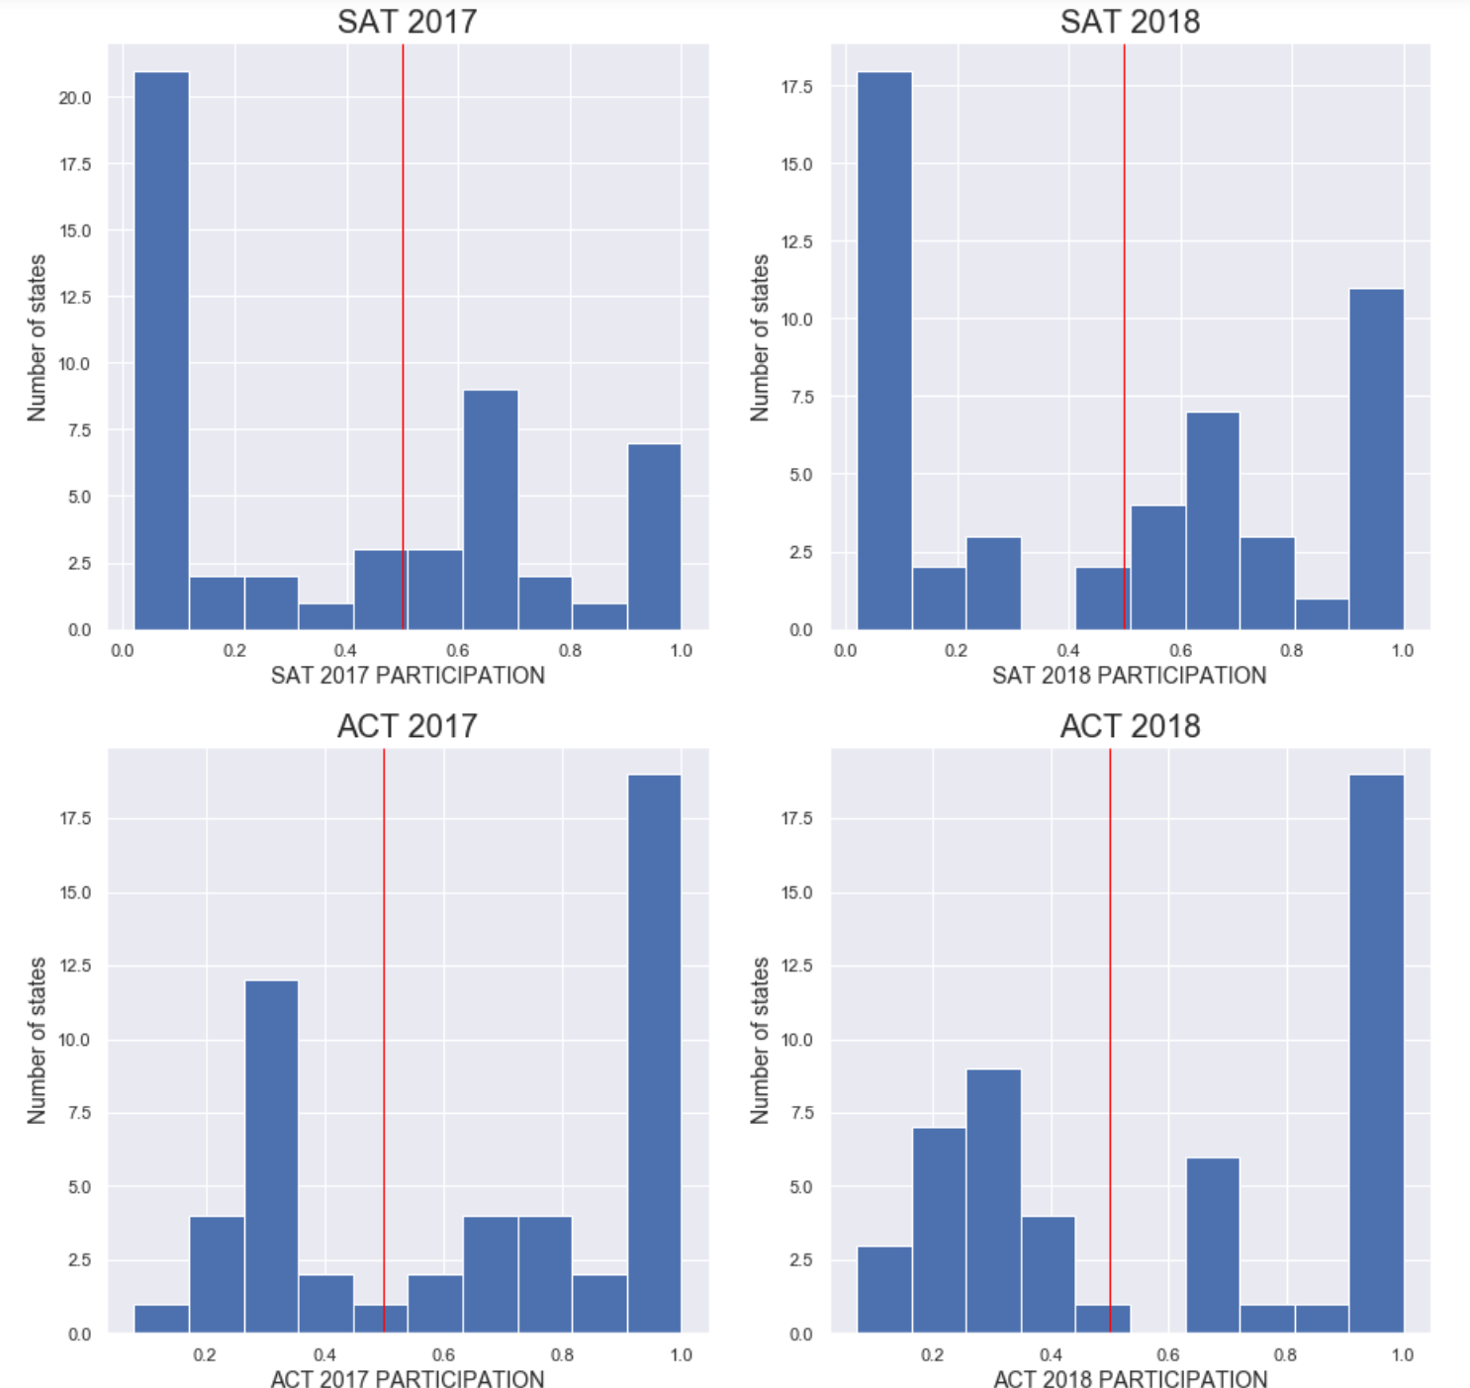
Participation

Slide 10
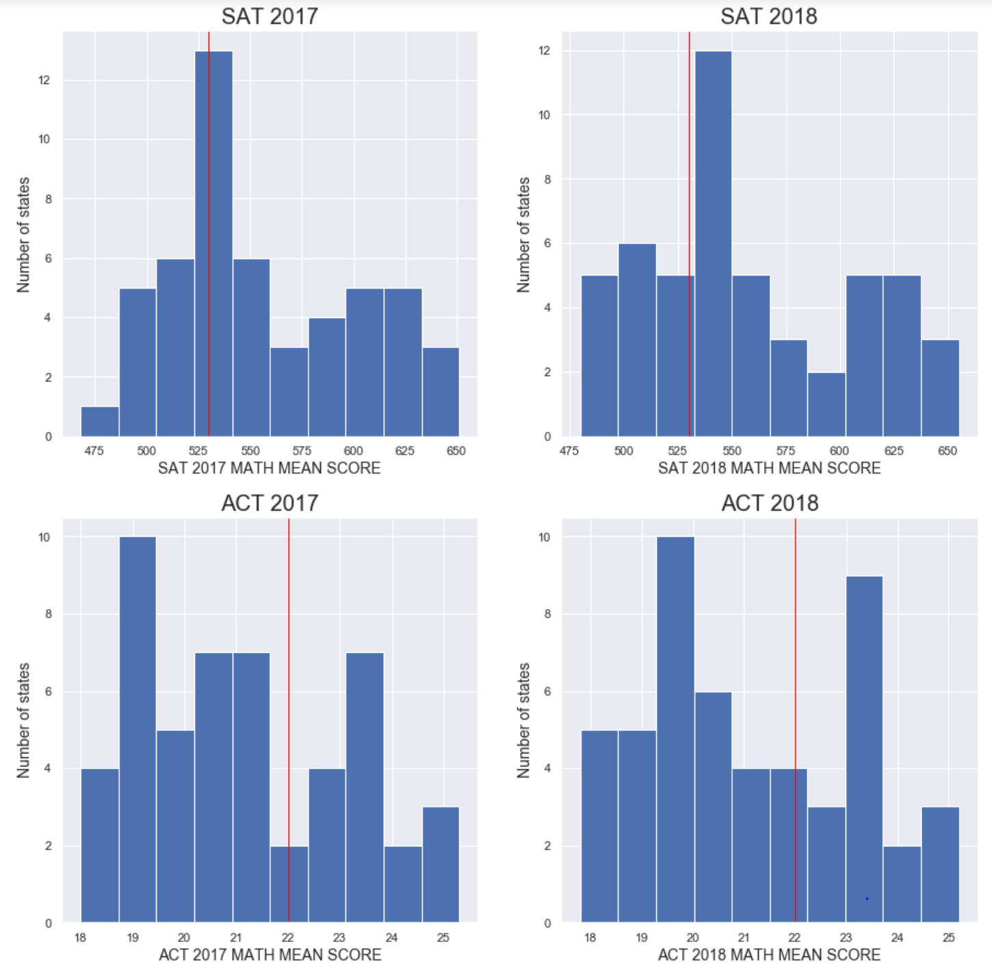
Mathematics

Slide 11
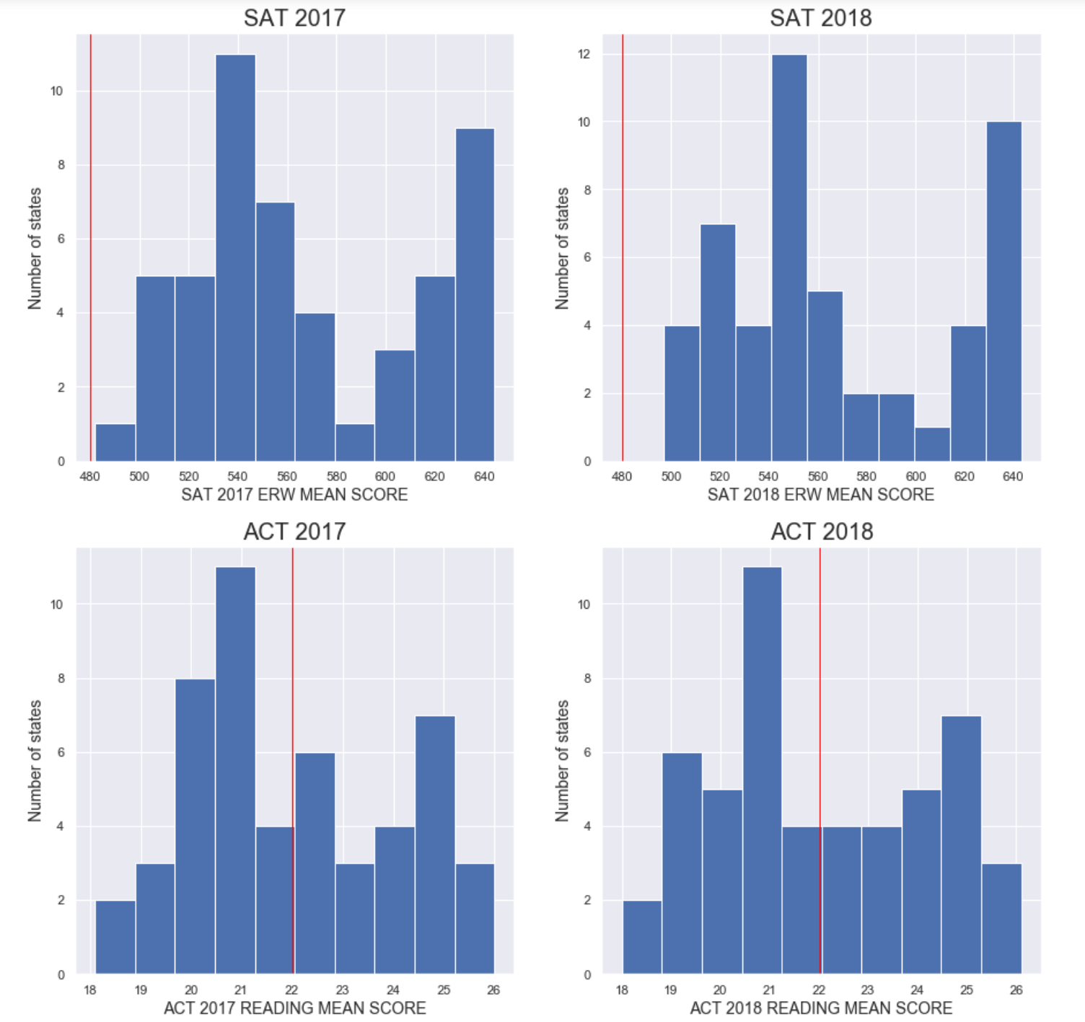
ERW vs Reading

Slide 12
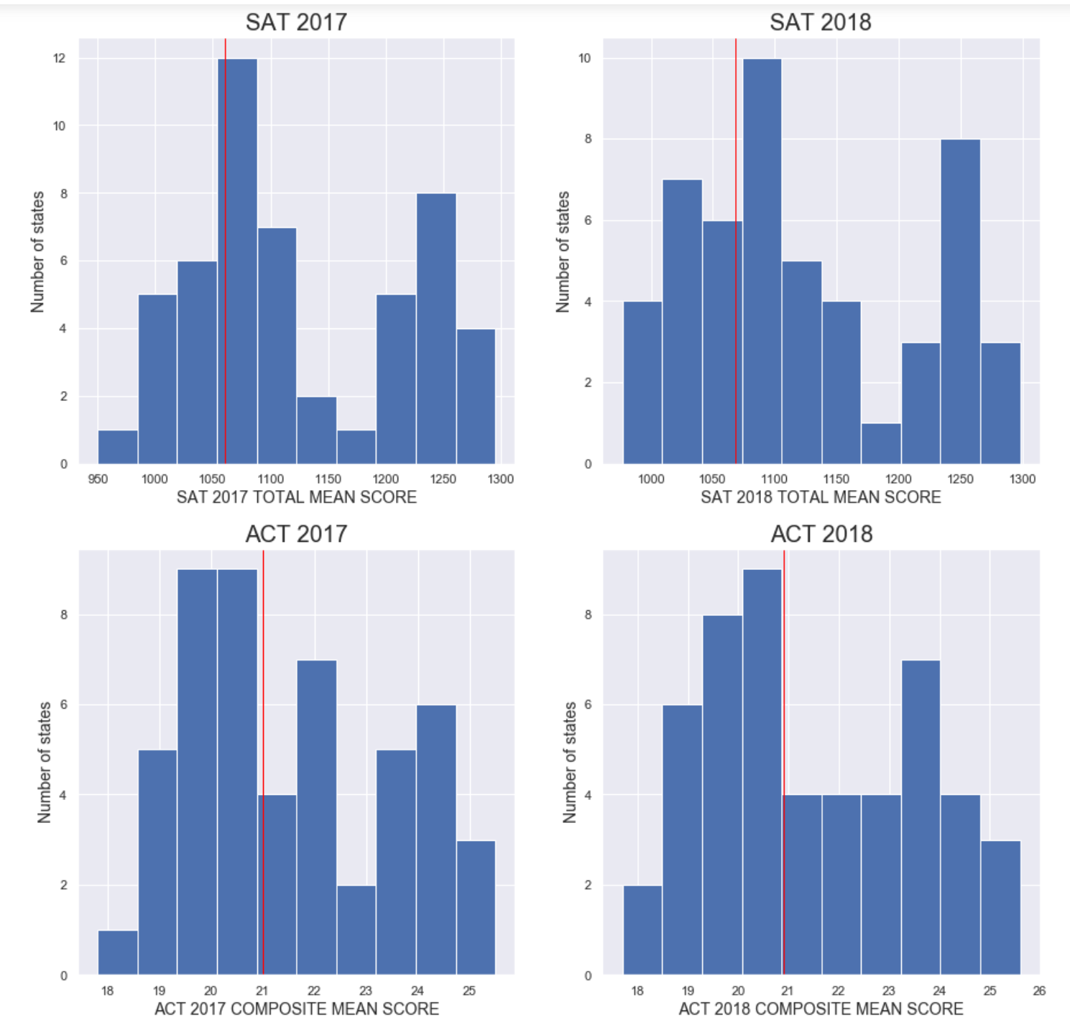
Total Mean vs
Composite Mean

Slide 13
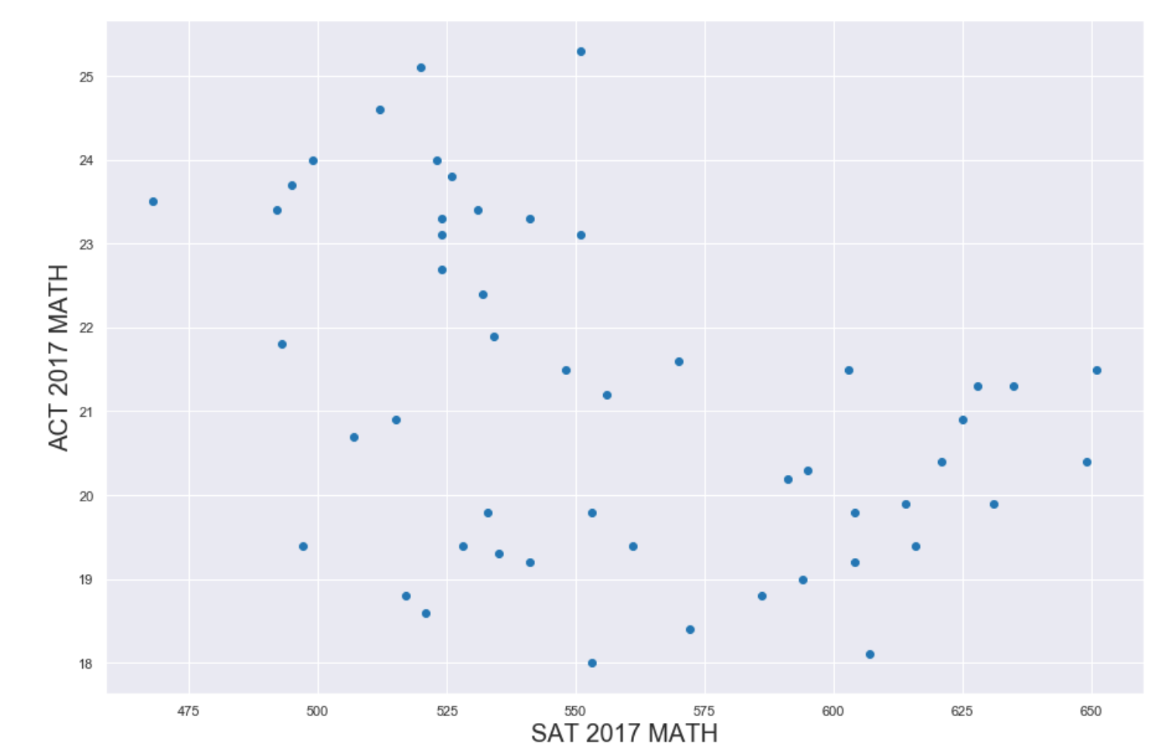
ACT Math vs
SAT Math
2017

Slide 14
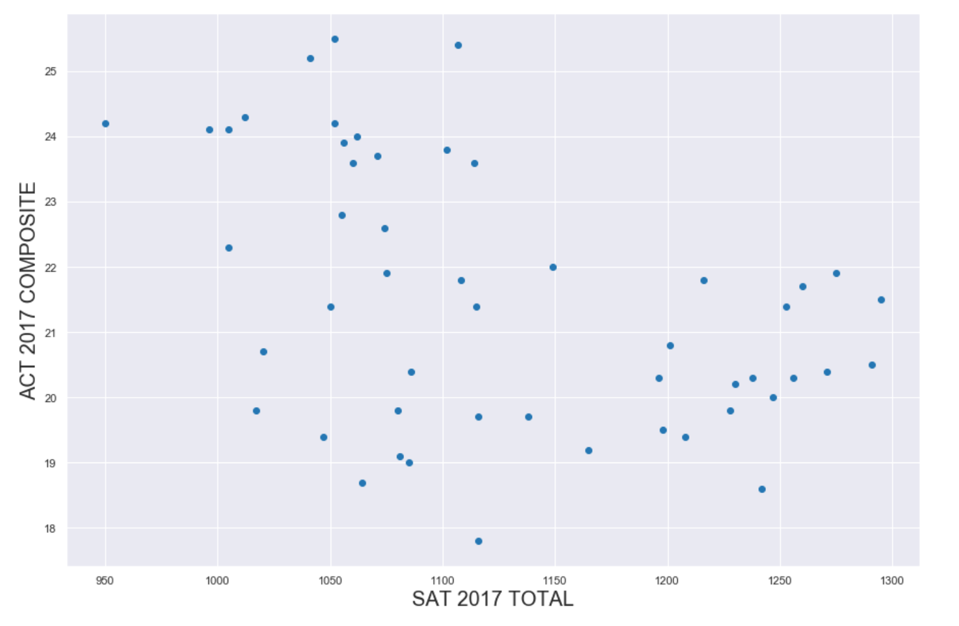
ACT 2017 Comp
Vs
SAT 2017 Total

Slide 15
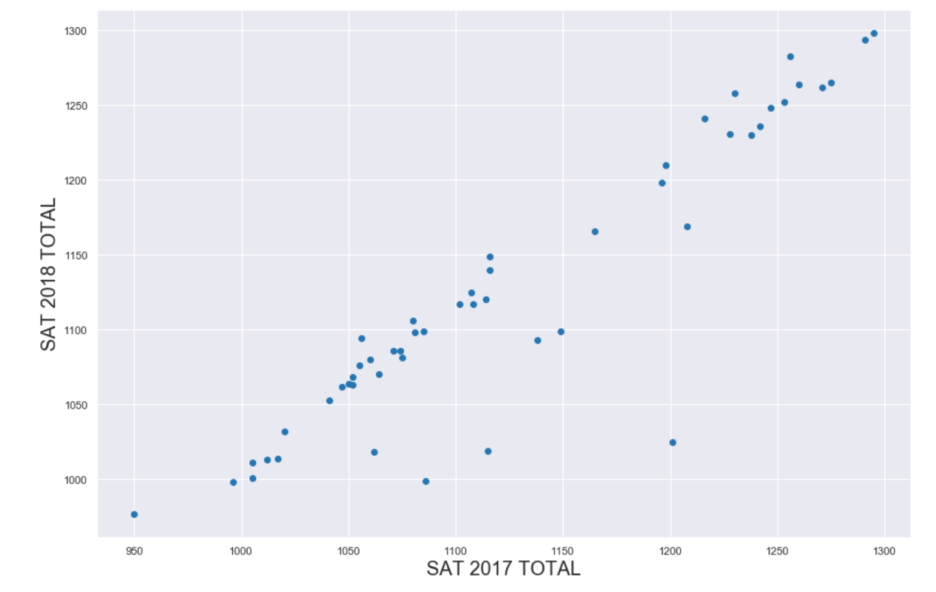
SAT 2018 Total
Vs
SAT 2017 Total

Slide 16
SAT 2018 Total
Vs
SAT 2017 Total

Slide 17
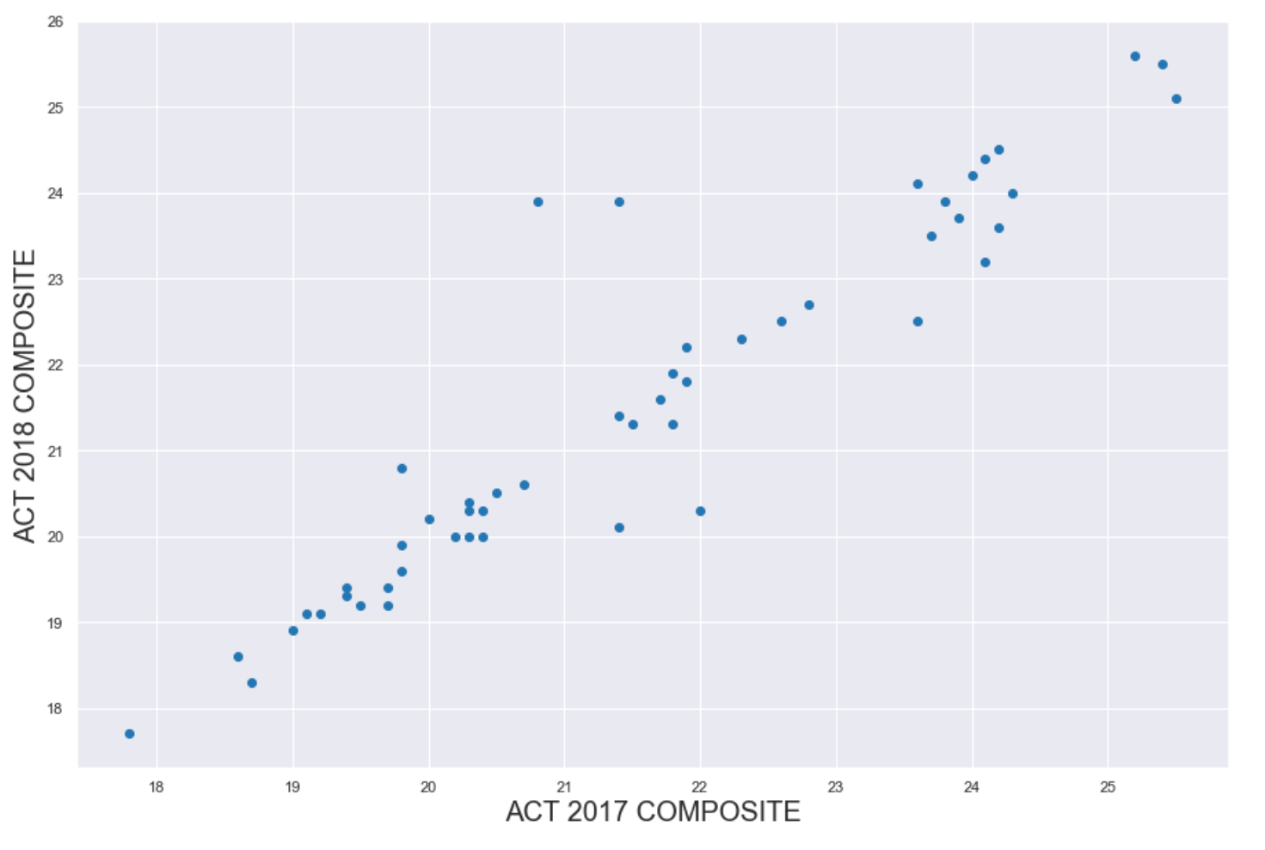
ACT 2018 Comp
Vs
ACT 2017 Comp

Slide 18
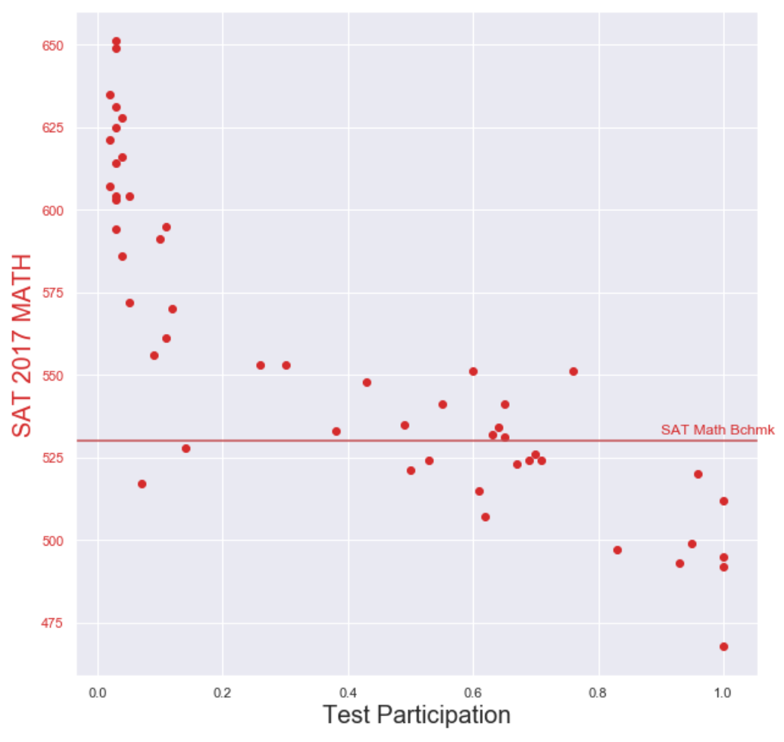
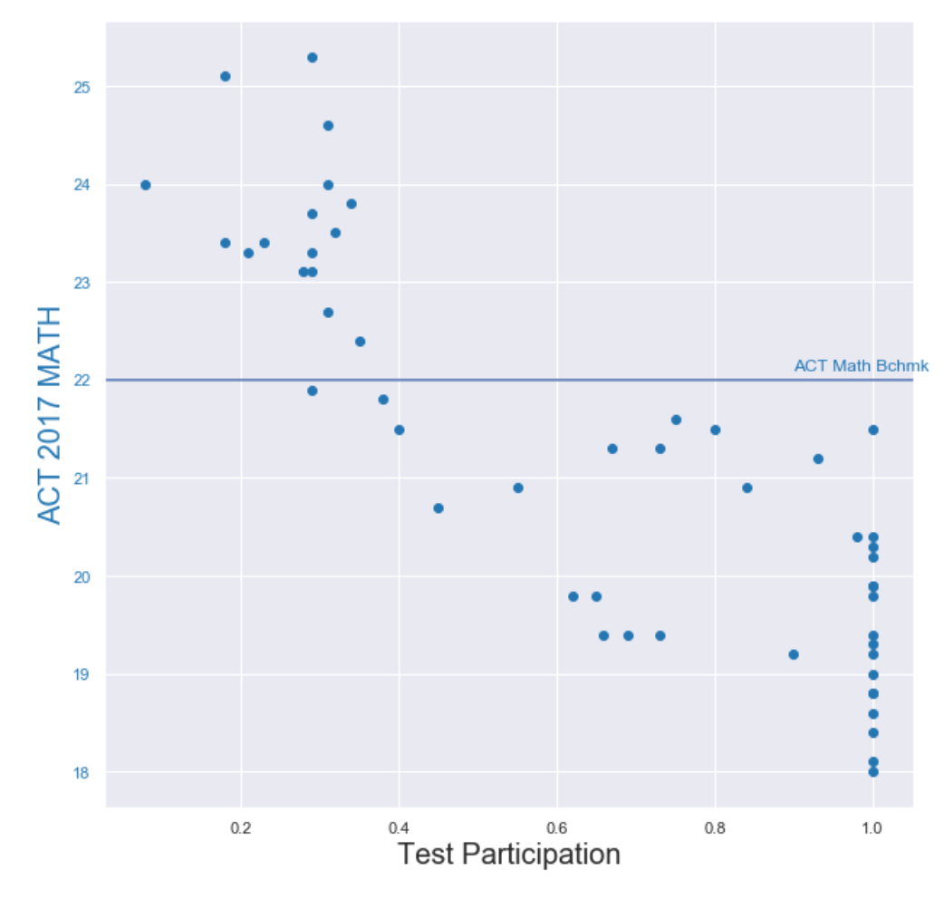
SAT & ACT MATH 2017 vs Benchmarks

Slide 19
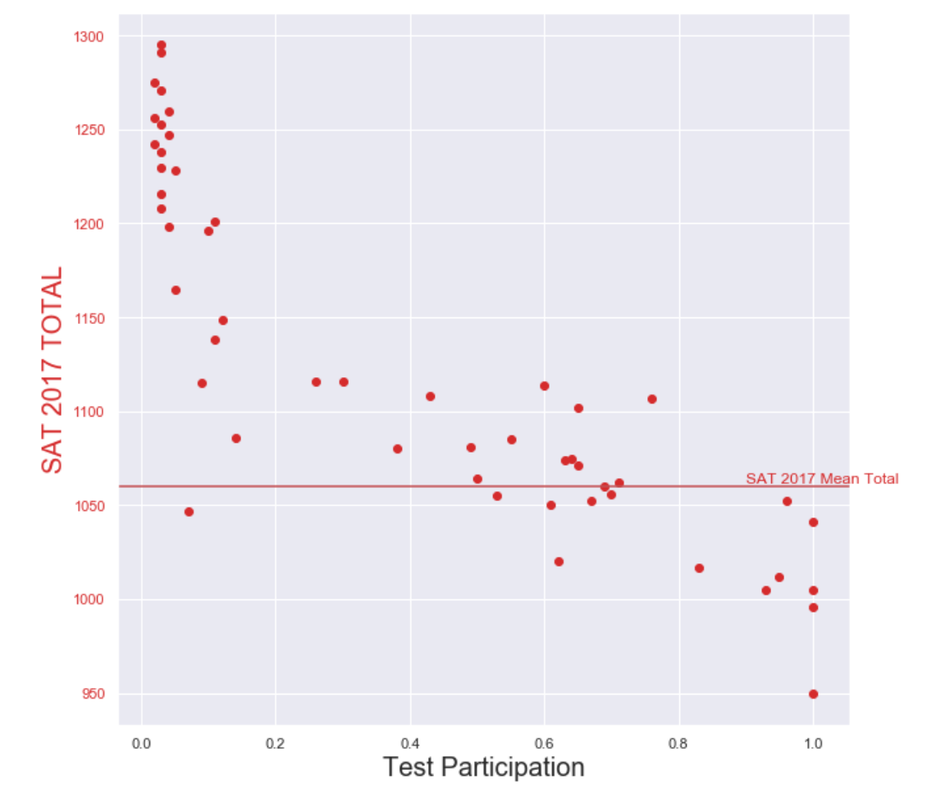
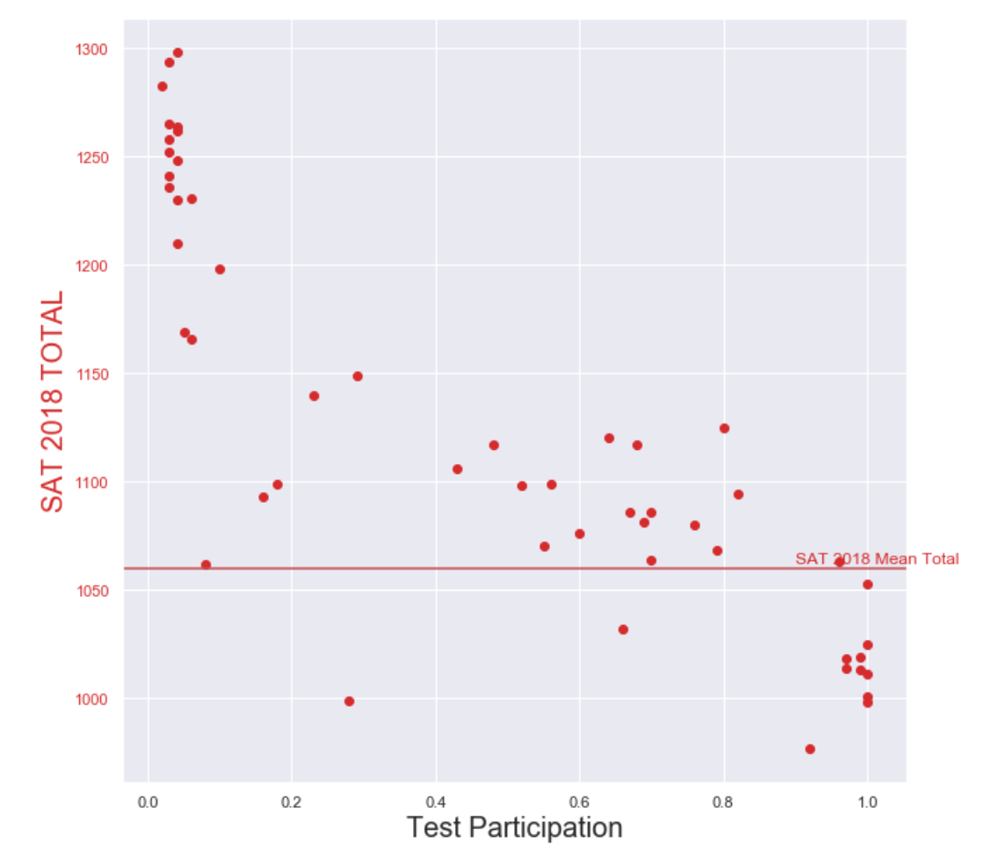
SAT TOTAL 2017 – 2018 vs Benchmarks

Slide 20
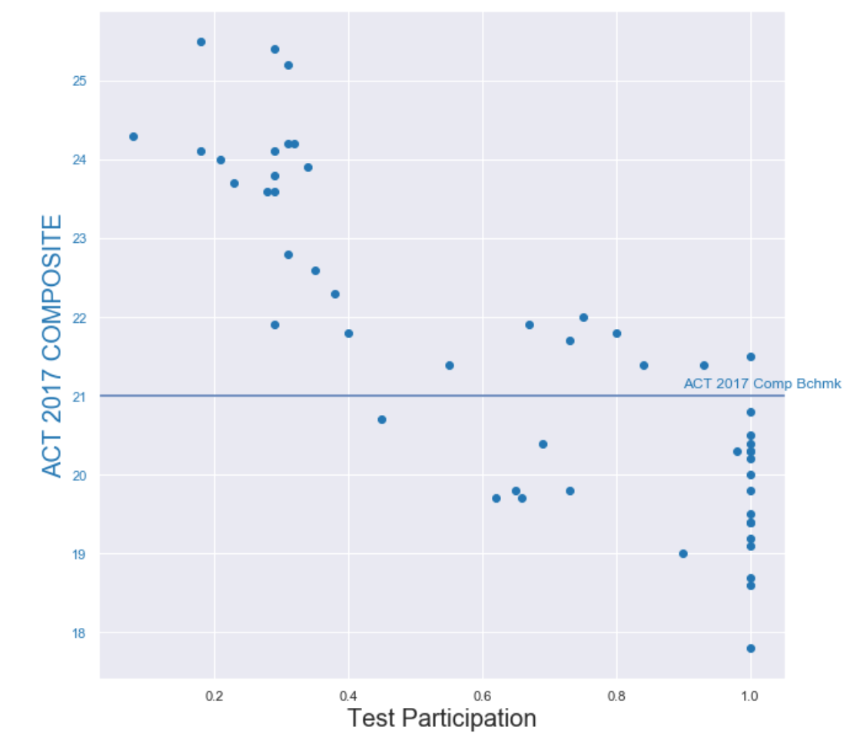
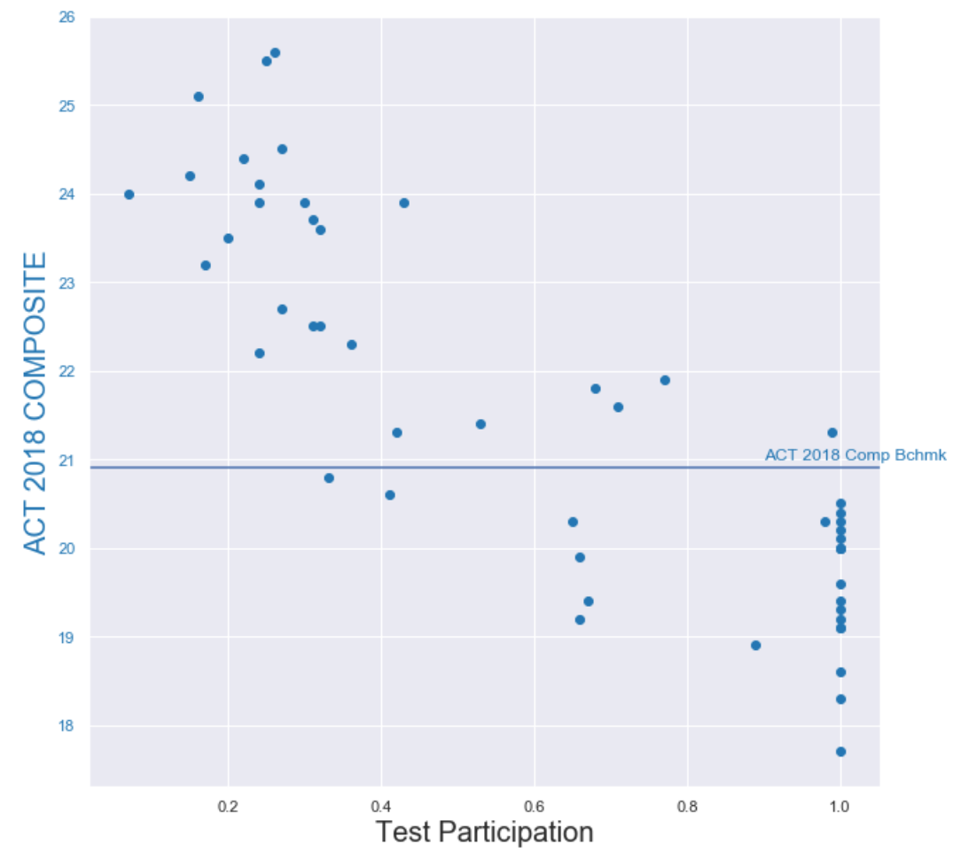
SAT TOTAL 2017 – 2018 vs Benchmarks

Slide 21
Scores vs Test Participation
Plotting scores against test participation rates and scoring benchmarks presents more meaningful findings.
Benchmarks
Many states do not meet the ACT benchmarks or SAT Benchmarks for each test.
Most state mean SAT Total scores are at or above the national mean.
Approximately half of all ACT state mean composite scores are at or above the national benchmark.
As participation levels increase, mean Total and Composite scores decrease.

Slide 22
Scores vs Test Participation
Participation
Numerous states have full participation in the ACTs and SATs.
More "normal" results are included where all students participate in the tests, thus lowering the state averages
Most states with high mean scores have low participation rates.

Slide 23
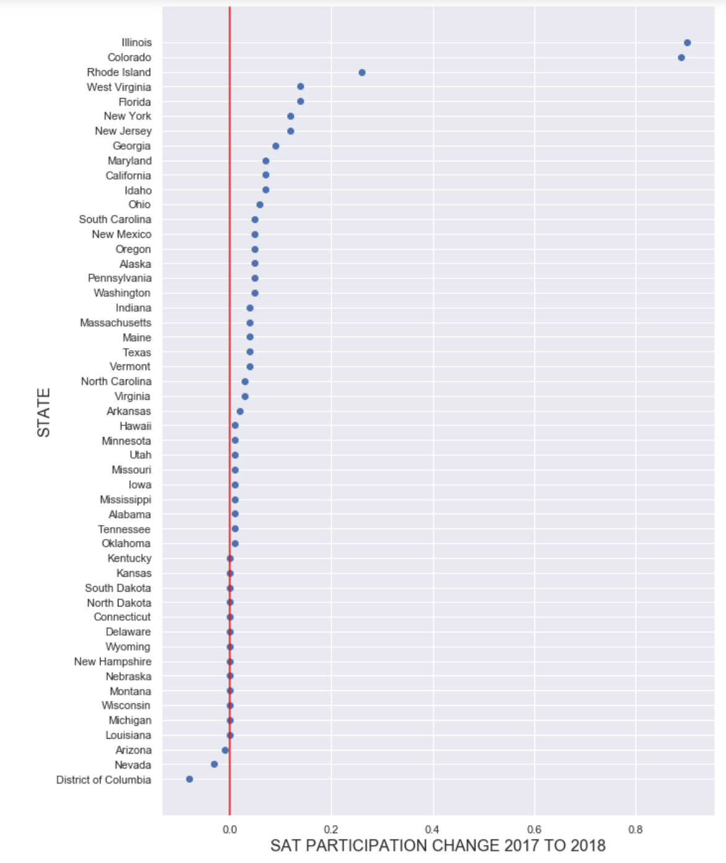
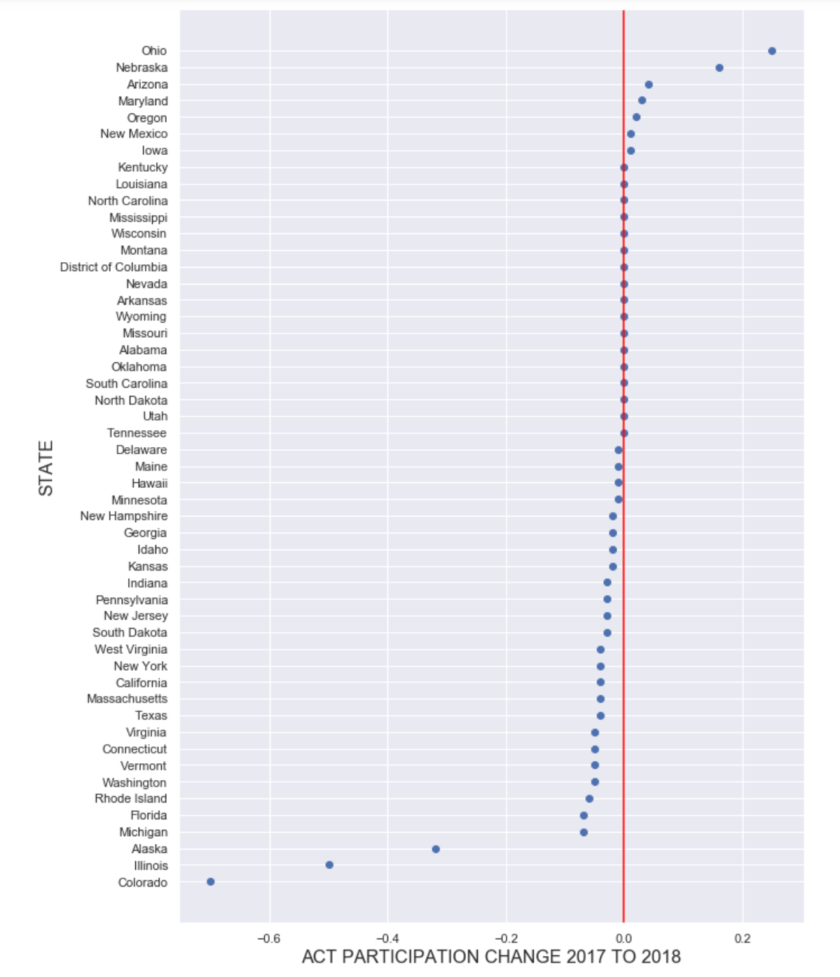
Impact of Change: Participation

Slide 24
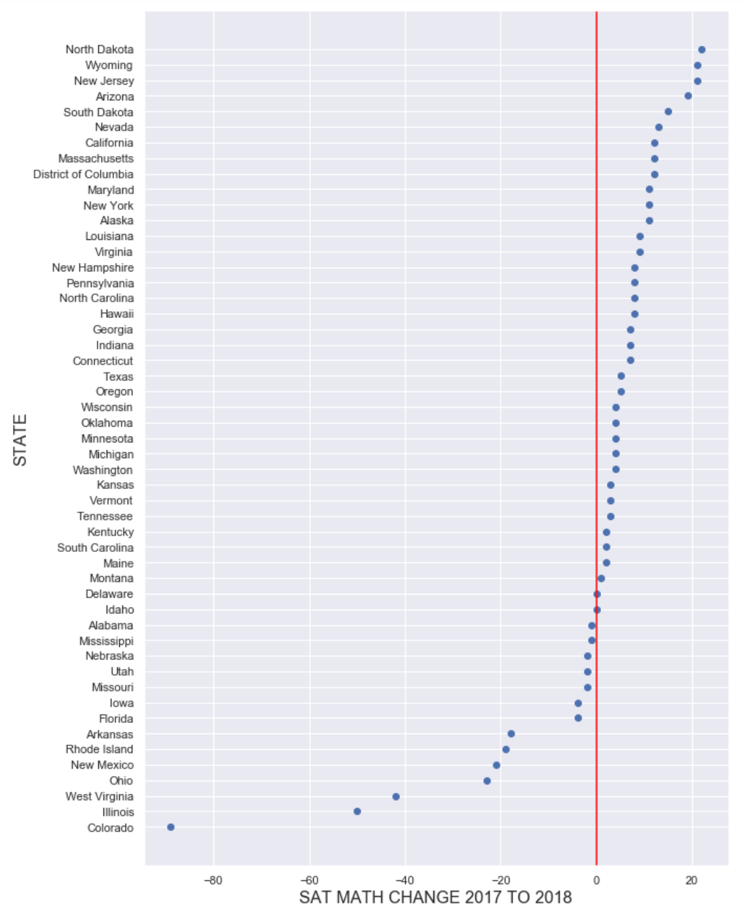
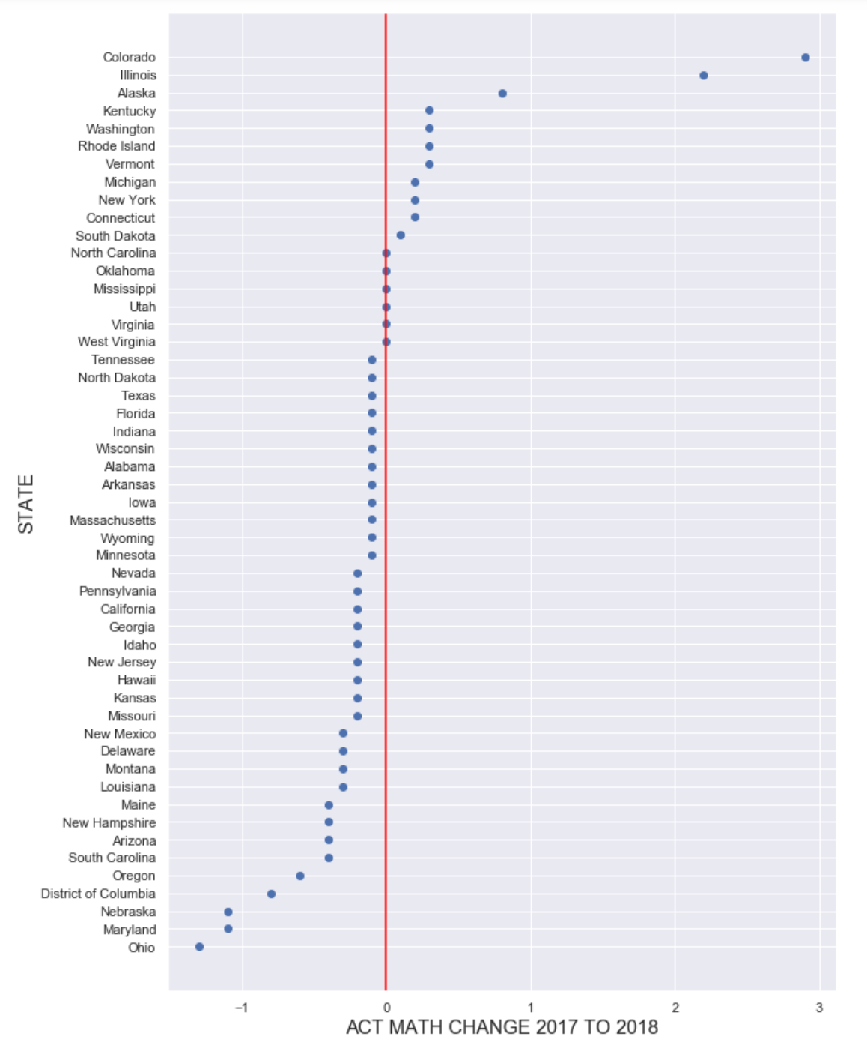
Impact of Change: Mathematics

Slide 25
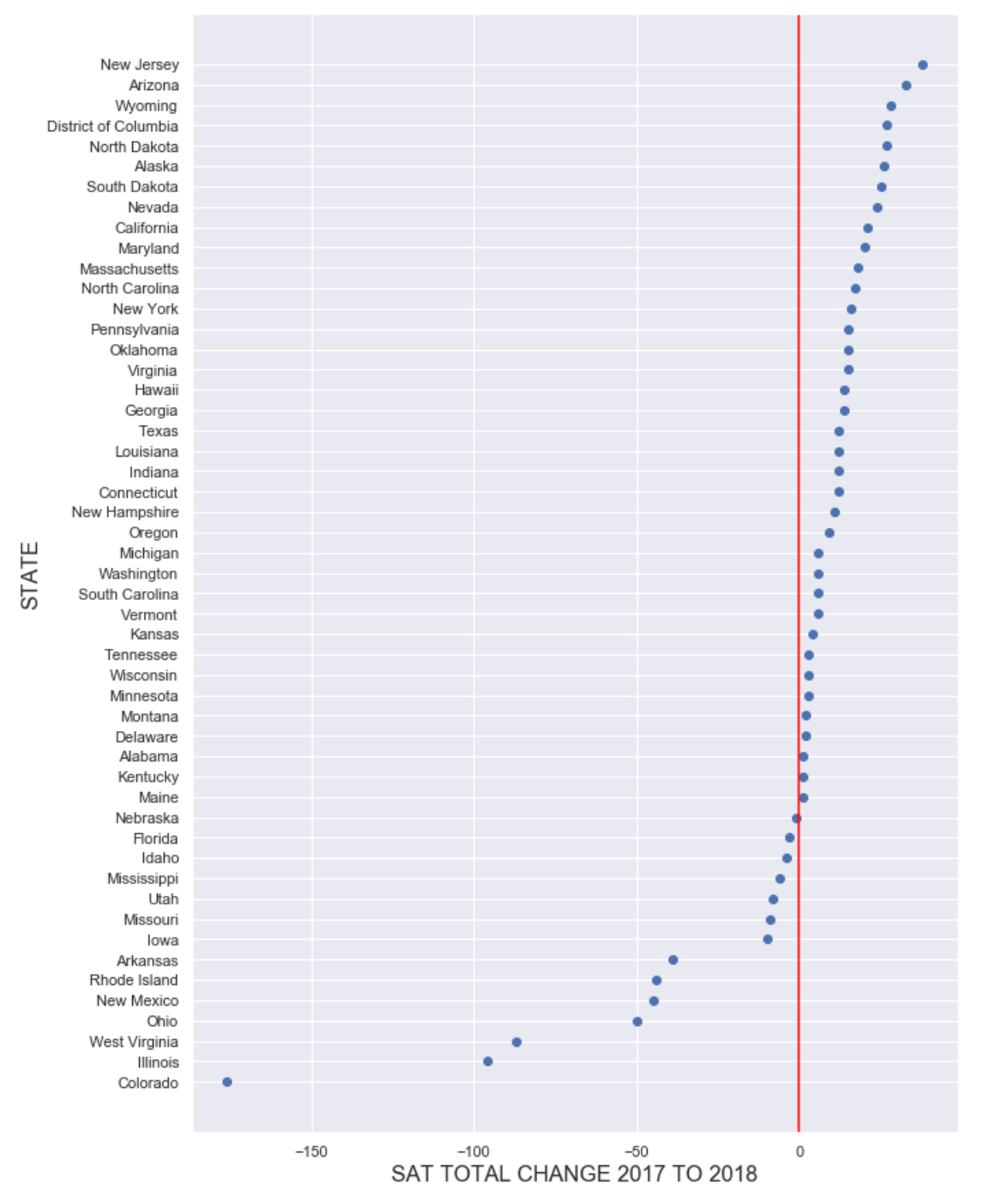
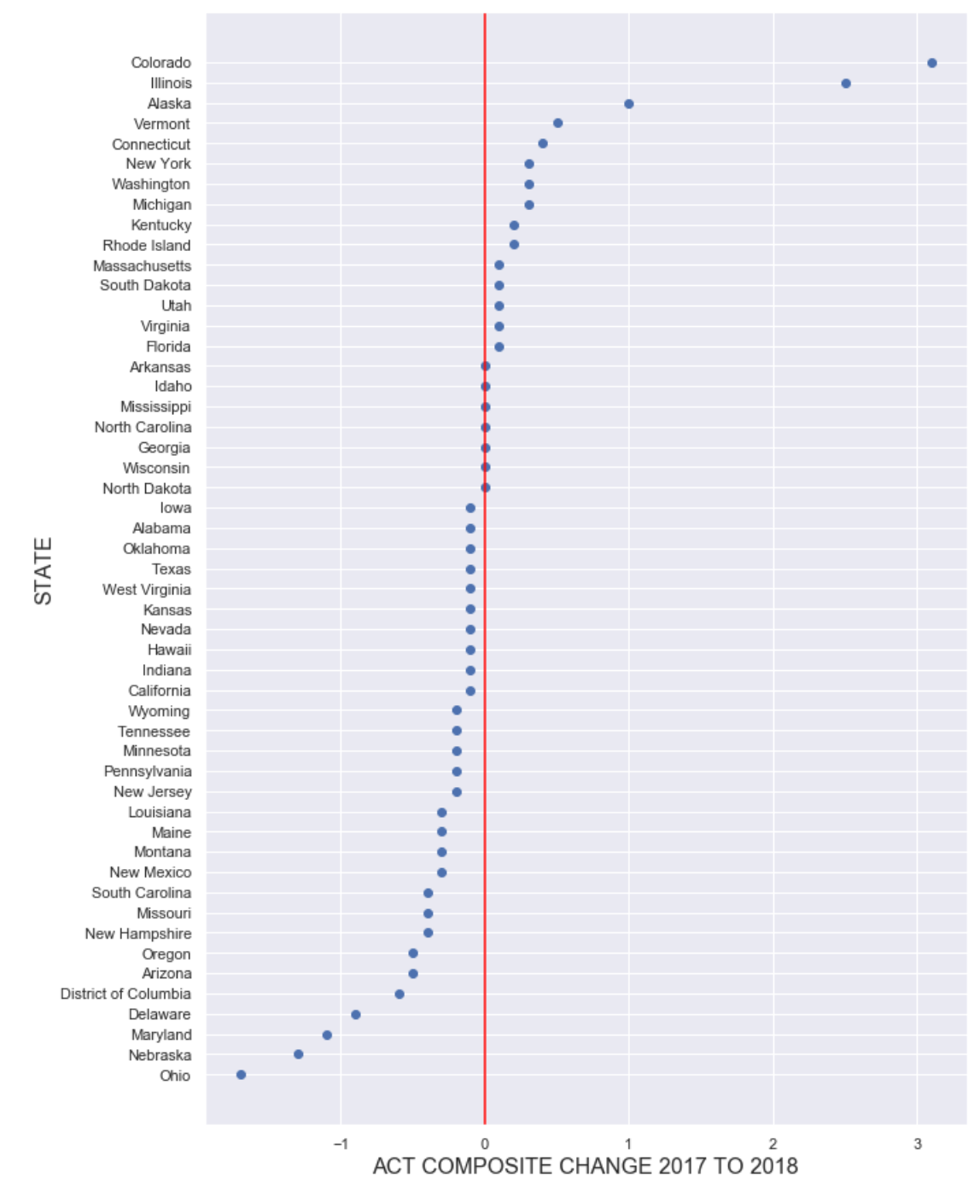
Impact of Change: TOTAL and Composite

Slide 26
Relationship: SAT & ACT Participation
It could be a justifiable comparison because:
Same kind of metric
Participation for test used in college admissions
Exactly the same scale (0.00 to 1.00)
It is possible to establish a reasonably accurate correlation value.

Slide 27
Relationship: SAT & ACT Participation
However, without additional data, further issues can crop up:
They are not entirely independent variables.
Test participation rules vary across the states
Each is a major exam that can be used for college admission
Taking one test likely means not taking the other

Slide 28
Relationship: SAT & ACT PArticipation
Issues (Cont’d):
The populations of each state are not reflected directly in the participation data.
Some states, such as Florida, have high populations (147,058 students).
High population more likely to drastically lower mean scores than for a less populous state
147,058 students in Florida vs. 14,834 students in Rhode Island
They have a strong negative correlation with each other (approx. -0.8)

Slide 29
States to WAtch
Illinois
Colorado
Alaska

Slide 30
States to WAtch
Illinois
State government of Illinois made the SATs compulsory and started phasing out the ACT in 2016
Strong incentives given:
State sponsorship
Tested at taker’s convenience

Slide 31
States to WAtch
Colorado
Similar to Illinois, the state of Colorado signed a contract with the College Board to adopt and push the SAT in 2016.
Students were strongly incentivised:
State sponsorship
High convenience

Slide 32
States to WAtch
Alaska
Saw a large drop in ACT participation rates because the ACT was "losing ground" nationwide.

Slide 33
States to WAtch
Interesting observations:
All 3 states saw sharp dips in ACT participation
All 3 states saw the largest increases in mean scores for the ACTs
This supports the idea that:
Increased participation lowers overall means scores and
Decreased participation raises overall mean scores.

Slide 34
Conclusion
Changes to SAT test structure have had a major impact on the US education system.
Whether it is positive and long-lasting is inconclusive for now.
More samples are required for accurate predictions.

Slide 35
Recommendations to College Board
Continue reviewing how the new SAT format affects participation levels and test scores.
More data required to make more conclusive analysis
Factor in student populations in data to give context to participation levels
To ensure future dominance, ensure higher adoption of SAT now
Obtain more government contracts for delivery of SAT exams

Slide 36
One state to look out for
District of Columbia
DC’s SAT participation rate saw a decrease with no perceptible corresponding increase in ACT participation rates.
Possible that DC students may still be taking the ACTs because it is more advantageous.
College Board could try negotiating with private colleges to offer more incentives to take SAT:
More scholarship money
Better perks
Prestige

Slide 37
Key Takeaways
Data loses its meaning without context.
Research can explain numbers, but numbers cannot tell a story by themselves.
EDA helps you understand your data and what areas to research in order to make your analysis more accurate.
The more similar the dependent variables of two datasets, the more equitable the comparison.
Craft a good problem statement:
Essential for effective and efficient execution of EDA.

Slide 38
Questions?

Slide 39
Thank you!

Slide 40
References
Business Insider: SAT is changing the format of its test in 2016
College Board's official report on the SAT re-design
https://www.act.org/content/dam/act/unsecured/documents/pdfs/R1670-college-readiness-benchmarks-2017-11.pdf
https://collegereadiness.collegeboard.org/about/scores/benchmarks
https://blog.prepscholar.com/average-sat-scores-by-state-most-recent
https://www.edweek.org/ew/section/multimedia/states-require-students-take-sat-or-act.html
https://www.chicagotribune.com/news/ct-illinois-chooses-sat-met-20160211-story.html
https://www.washingtonpost.com/education/2018/10/23/sat-reclaims-title-most-widely-used-college-admission-test/
https://www.edweek.org/ew/articles/2018/10/17/math-scores-slide-to-a-20-year-low.html
https://www.act.org/content/dam/act/secured/documents/cccr2018/National-CCCR-2018.pdf

